Slide 1
External Evaluation Methodology
Hellenic Consulting Ltd

Slide 2

Evaluation Purpose
Internal Monitoring
Led by South East European Research Centre-SEERC, as project Quality Assurance Manager
and capture deliverables as well as the process of strengthening the links between HEIs and business sector, providing an objective view of the progress of MechaUZ project…
measure the expected impact…
External Evaluation
Led by Hellenic Consulting Ltd., as appointed through tender process

Slide 3



Meet Our Team
HELLENIC
CONSULTING Ltd…
…is a legal company based in Thessaloniki (Greece) and was established in 2006;
we provide business consultant services, with long experience in EU funded programme evaluations…
certified with ISO 9001:2015 & SA8000:2008
info@helleniconsulting.gr

Slide 4

Evaluation Principles
How has the project enhanced cooperation for university-industry links?
Impact
What mechanisms have been used to turn resources into outputs and results?
How far has the project achieved its specific objectives?
Efficiency
Effectiveness
Are the benefits expected to last after the project is over?
How transferable is the project approach?.
Sustainability
Relevance
Utility
Added Value
Does the project have an impact on the target groups in relation to their needs?
Would the intervention have happened without financial assistance?

Slide 5
Evaluation Timeline
Interim report
(a draft version will be shared with partners on March 2021)
April
2021
October 2022
Final report
(a draft version will be shared with partners on September 2022)

Slide 6

Indicators Assessment
Quantitative Indicators
Assessment of measurable outcomes by analyzing differences between achievements (reality) and expected (proposal)
You can simply impress your audience and add a unique zing and appeal to your Presentations.
Quantitative Indicators
Assessment of impacts based on partners’ and target groups’ experiences, risk identification and added value complementation
Quantitative and Qualitative assessment of programme impacts will be undertaken both in interim and final evaluation reports

Slide 7
Quantitative Indicators Assessment
No. of…
SOS!!
students, academics, engineers using i-labs
participants in Mechatronic Society (and their profile)
followers on social media
publications (journals, etc.)
participants registered in final conference…
in order to assess No. of students interested, a note on UZB HEIs websites should be available (number of unique visitors)
No. of…
SOS!!
students interested in studying in new BSc and being taught as well
academic staff trained
specialists interested in new courses…
in order to assess demand for textbooks/manuals, a download counter should be incorporated in project’s website

Slide 8
Qualitative Indicators Assessment
01
Partners’ perceptions regarding project management, challenges
online quantitative survey (Google form) / all members / conducted twice (Annex 1)
online interviews (ZOOM) / members’ sample / conducted twice (Annex 2)
Partners’ perceptions regarding project progress
02
online quantitative survey (Google form) / all members / conducted twice (Annex 3)
03
Target groups’ perceptions regarding courses & training
online quantitative survey (Google form) / students; academic staff; engineers/ when courses are completed (Annex 4)
online interviews (ZOOM) / target groups’ sample
ACCESS TO REGISTRATION LISTS!!
Target groups’ perceptions regarding I-labs usability
04
online quantitative survey (Google form) / users sample / when I-labs completed (Annex 5)
ACCESS TO REGISTRATION LISTS!!
05
Uzbek teachers’ perceptions regarding inter-partner training
online quantitative survey (Google form) / 12 teachers / when training is completed (Annex 6)

Slide 9
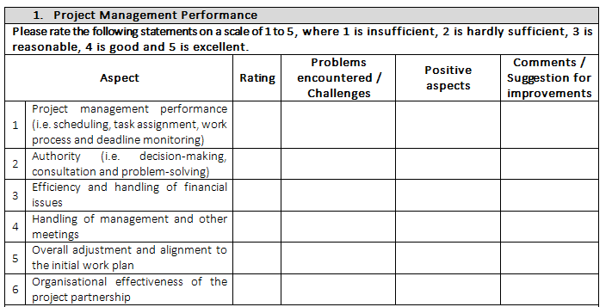

Annex 1: Evaluation Questionnaire for project partners
Annex 2: Evaluation Questionnaire for project partners

Slide 10


Annex 3: Evaluation of progress by project partners for year 1
Annex 3: Evaluation of progress by project partners for year 2

Slide 11
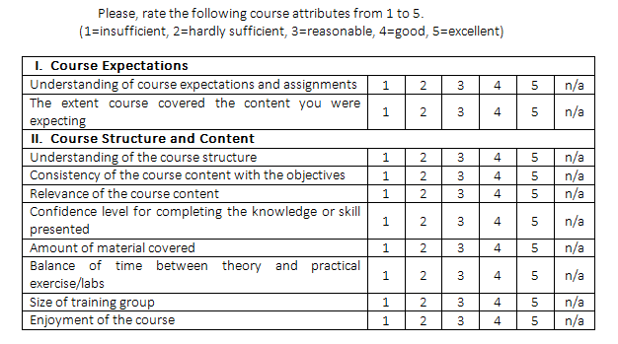
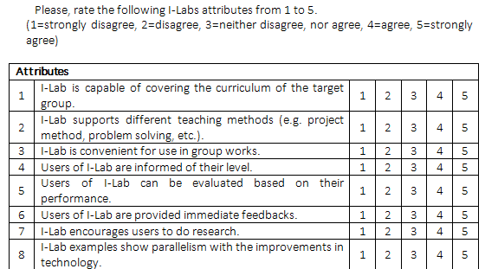
Annex 4:
Post-Course Evaluation Questionnaire
Annex 5:
I-Labs Evaluation Questionnaire

Slide 12
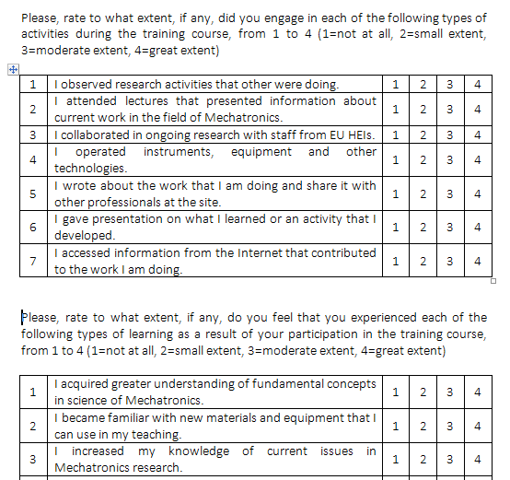
Annex 6:
Teachers’ Training Conducted by EU HEIs Evaluation Questionnaire

Slide 13
Thank you for listening!
Any questions?

